Slide 1
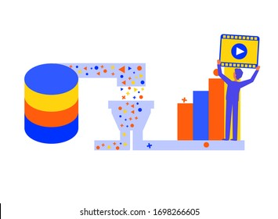

Hybrid Movie Recommender System
Yusri Al-Sanaani
Notes:
Hi everyone, my name is Yusri, I have a bachelor in BME, MS in m and currently doing a Meng in electrical and computer eng with Concentration in ML and DL. Today, I will walk you through Hybrid movie recommender system.

Slide 2
Motivation
Recommender Systems
Information filtering system
Improve the quality of search results
Provides more relevant items to the search item or search history of the user.
Why Recommender Systems?
Socially and economically critical for appropriate choices.
What is the problem?
Build a hybrid movie recommender system that combines user ratings and content of movies to provide top n recommendations.
Notes:
3 week ago, I went to best buy to buy a montor for my pc. Over all the options there, I got confused about which the bet choice for me and left without buying anything, it was difficult for me to decide which one is better over many types of mintors. my friend advised me to buy LG monitor, when searched for it on Amazon.ca, the website suggested another one with higher rating ,better reviews and good price. This motivated my curiosity to discover the idea behind such recommender systems.
Recommender Systems are a type of information filtering system as they improve the quality of search results and provides items that are more relevant to the search item or are related to the search history of the user.
In today’s technology driven world, recommender systems are socially and economically critical for ensuring that individuals can make appropriate choices surrounding the content they engage with on a daily basis.

Slide 3
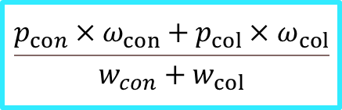
Recommender System Framework
EDA & Preprocessing
Movies Genres
KNN
Evaluation Metrics:
Root Mean Squared Error (RMSE)
Mean Absolute Error (MAE)
Hit Rate (HR)
Novelty
Coverage
Diversity
Content
Cosine Similarity
$$\frac{p_{con}×ω_{con}+p_{col}×ω_{col}}{w_{con}+w_{col}}$$
Hybrid
SVD
MovieLents dataset
Collaborative
Users interactions
KNN
Recommender System

Slide 4
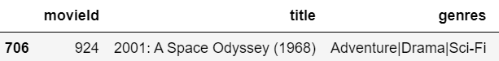
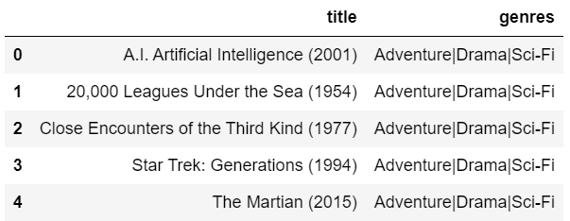
Content Based Recommender
Test Sample:
Content Based
TFiDF/BOW (Genres)
Cosine Similarity
KNN
Rank Movies (Ratings)
Movies data
Recommendations:
Rating data
Top N

Slide 5


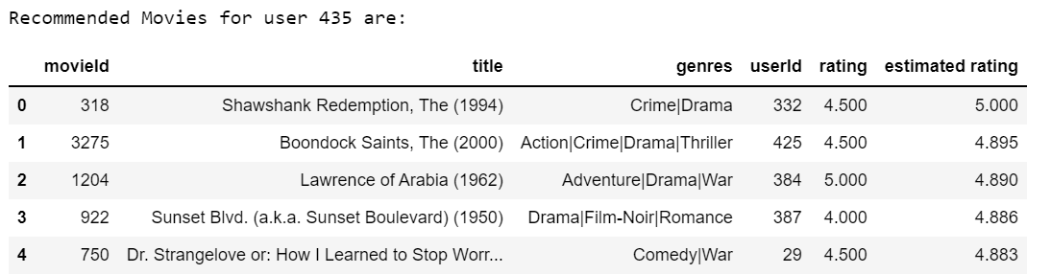
Collaborative Based Recommender
C
B
B
A
SVD is the best to predict the ratings based on similarity of users-movies interactions.
A
Similar taste!
User 1
User 2
Notes:
On other hand, Collaborative RS filter out movies that a user might like based on ratings of similar users.
For example, if user 1 and 2 watched the same A and B movies, user 1 might like movie c as well.
SVD has been used to predict the ratings based on the similarity of users-movies interactions

Slide 6
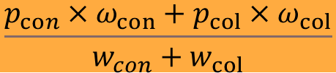
Hybrid Recommender
Movies dataset
Content Based
Hybrid
Prediction
Rating dataset
Collaborative Based
$$\frac{p_{con}×ω_{con}+p_{col}×ω_{col}}{w_{con}+w_{col}}$$

Slide 7
Hybrid Recommender
Recommendations (content-KNN):
Black Mask (Hak hap) (1996) 3.80
Joy Ride (2001) 3.80
What's Up, Tiger Lily? (1966) 3.80
Missing, The (2003) 3.77
City of God (Cidade de Deus) (2002) 3.76
Recommendations (collaborative-SVD):
Wallace & Gromit: A Close Shave (1995) 4.50
Annie Hall (1977) 4.40
Lock, Stock & Two Smoking Barrels (1998) 4.35
American History X (1998) 4.33
On the Waterfront (1954) 4.32
Recommendations (Hybrid):
City of God (Cidade de Deus) (2002) 3.99
Matrix, The (1999) 3.94
Indiana Jones and the Last Crusade (1989) 3.92
Rear Window (1954) 3.89
Midnight Run (1988) 3.88

Slide 8
Evaluation Metrics
RMSE: Root Mean Squared Error.
MAE: Mean Absolute Error.
Lower error values mean better accuracy.
HR: Hit Rate
cHR: Cumulative Hit Rate
ARHR: Average Reciprocal Hit Rank
Higher is better.

Slide 9
Evaluation Metrics

Slide 10
Conclusions
Recommender System (RS)
Content based RS– Cosine Similarity and KNN on Genres (TFiDF & BOW).
Collaborative based RS– SVD.
Weighted Hybrid RS (Content+ Collaborative).
Challenges:
Computation & Time.
Future Work
Use PySpark to handle the massive data.
Try deep learning.

Slide 11
Thank You!
LinkedIn: https://www.linkedin.com/in/yusri-al-sanaani/
GITHUB: https://github.com/yusrialsanaani
Email: yusrialsanaani@gmail.com

Slide 12
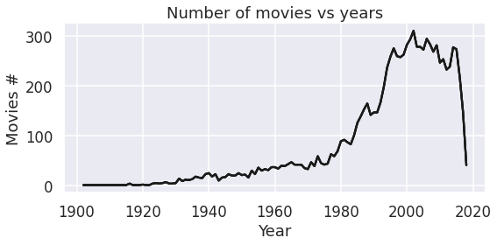
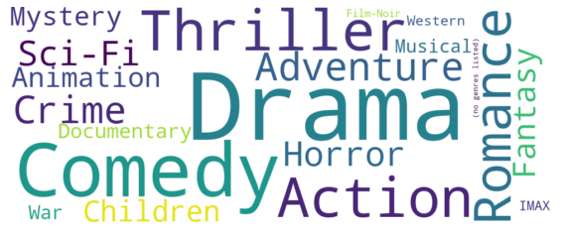
EDA – Movies Data
Movies Genres
Movies Distribution Over Years
Number of unique movies: 9737
Number of unique genres: 19
Number of unique movie release years: 107.
Notes:
The movies dataset contains more than 9 thousnads movies categorized into 19 genres, distributed over more than 100 years.

Slide 13
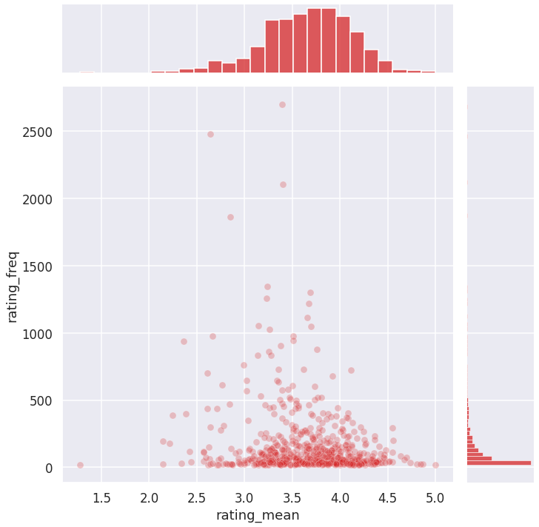
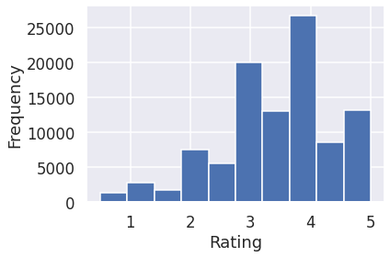
EDA – Ratings Data
610 unique users rated 9724 unique movies.
Ratings: [0.5 - 5 ]
Average rating: 3.5
The most frequent rating value is 4.
Sparsity level is 98.3%
Notes:
Joinplot illustrates Interaction between ratings and rating frequency, there is only a subset of values with higher rating that have considerable amount of ratings.
High sparsity levels pose a big challenge to the quality of predictions, as well as to the number of predictions that a recommender system can actually compute.
Because of sparsity, the confidence of predicted ratings may be questionable, since they are based on a rather little amount of evidence.
Data sparsity refers to the difficulty in finding sufficient reliable similar users since in general the active users only rated a small portion of items.
Cold start refers to the difficulty in generating accurate recommendations for the cold users who only rated a small number of items.

